Slide 1
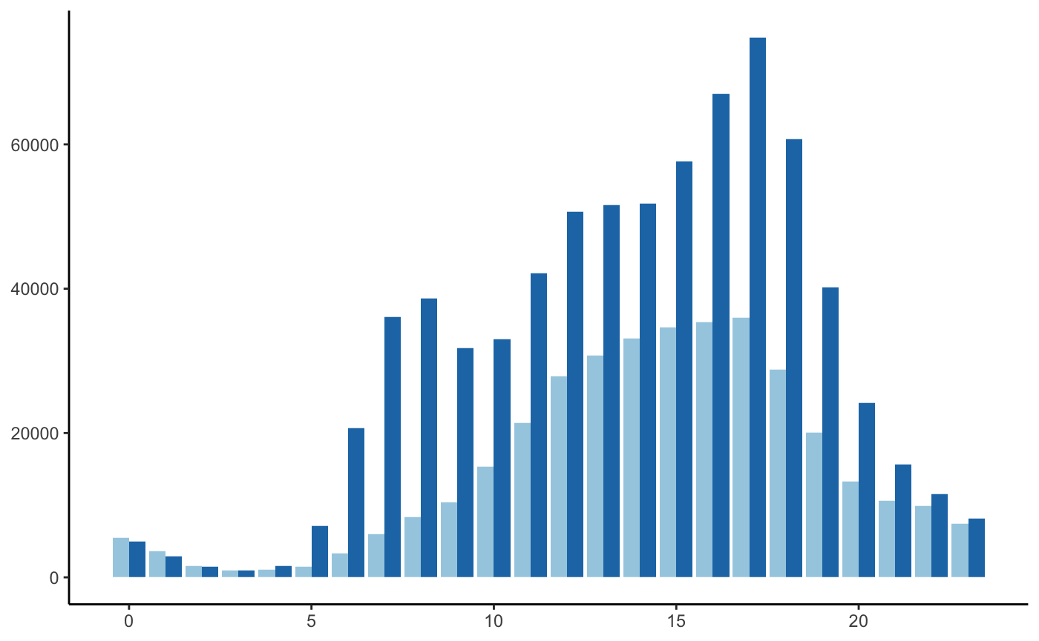
Divvy Member & Casual Rider Trip Start Times
Member rides peak more significantly during “rush hour” between 3 to 7 PM
Rush Hour
Number of Rides
Member
Casual Rider
Ride Start Time

Slide 2
Divvy Member & Casual User Ride Start Times
Member rides peak more significantly during “rush hour” between 3 to 7 PM
Rush Hour
Number of Rides
Member
Casual User
Ride Start Time

Slide 3
Divvy Member & Casual User Ride Start Times
Rush hour surge pricing will incentivize Casual Users to purchase memberships
AM Rush Hour
PM Rush Hour
Number of Rides
Casual User
Member
Ride Start Time

Slide 4
Change x axis to 6 hour interval
Add second callout for AM rush hour
Change sub-header?
Step 3 – Target draft of Friday,
1 – Dan
2 – Matt
3 – Will
4 – Sam
5 – Ansab
Ansab will create final draft over weekend
Ryne can tweak visual Mon afternoon if needed

